Slide 1
Presented by:
Richard Anderson
Overview of the RUS Distance Learning
and Telemedicine Grant Program
HealthTech Net
Washington, DC
December 14, 2018

Slide 2
Rural Utilities Service Telecommunications Programs
Telecommunications Infrastructure Loans and Loan Guarantees Program
Rural Broadband Access Loans and Loan Guarantees Program
Community Connect Grants Program
Distance Learning and Telemedicine (DLT) Grant Program

Slide 3
DLT Grant Program – Purpose

Slide 4
DLT Grant Program – Key Definitions

Slide 5
DLT Grant Program – Basic Requirements
Grants fund equipment needed to provide Distance Learning and Telemedicine services
15% Matching Requirement
Minimum Grant amount: $50,000
Maximum Grant Amount: $500,000
http://www.rd.usda.gov/programs-services/distance-learning-telemedicine-grants

Slide 6
Distance Learning and Telemedicine (DLT) Program
Funding | Activity
FY 2016 $23.4 million appropriated FY 2017 $23.6 million appropriated FY 2018 $29.0 million appropriated $20.0 million additional appropriation to help address the opioid epidemic in rural America | FY 2016 182 applications received 98 awards approved: $27.7 million 35 States & Territories represented FY 2017 208 applications received 86 awards approved: $27.7 million 46 distance learning & 40 telemedicine projects 30 States & Territories represented FY 2018 224 applications received 132 awards approved for $40.8 million

Slide 7
FY2018 Awards Breakdown
Distance Learning Telemedicine Overall
67 awards 65 Awards 132 awards
849 sites 758 sites 1,607 sites
32 States 39 states 45 states & Territories represented
$22.7 million $18.1 million $40.8 million
STEM & Opioid Special Consideration Point Projects
51 STEM 63 Opioid 18 None 132 awards
$18.6 million $17.8 million $4.4 million $40.8 million

Slide 8
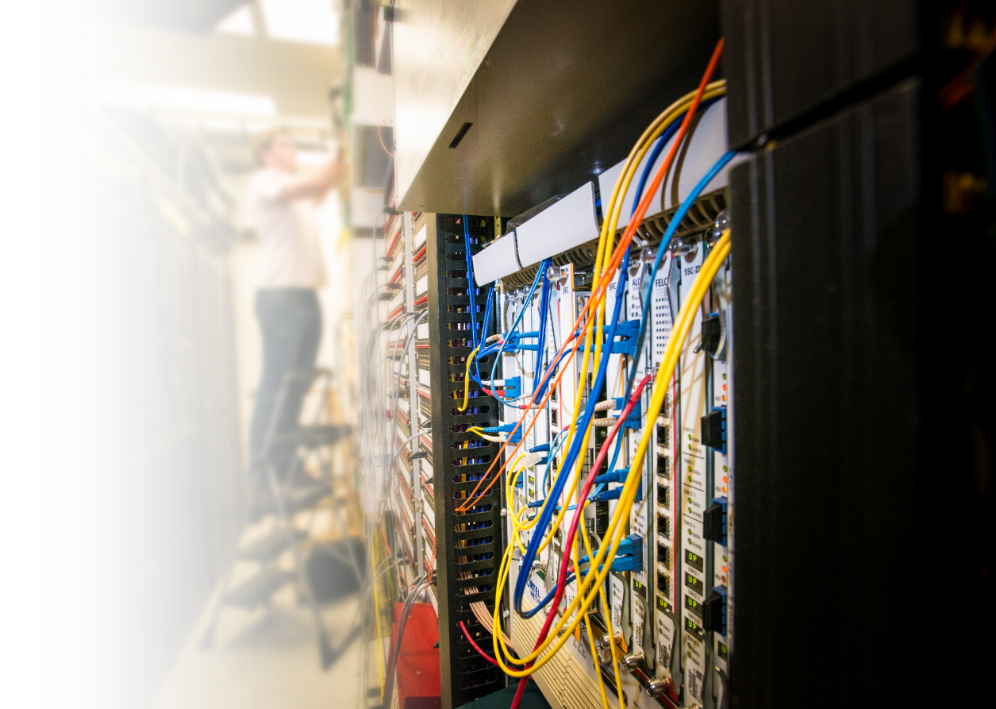
Expanding Broadband in Rural America
USDA Launches New Program to Create High-Speed Internet e-Connectivity in Rural America
Program was announced by Secretary Perdue on 12/13/2018, Press Release: https://www.usda.gov/media/press-releases/2018/12/13/usda-launches-new-program-create-high-speed-internet-e-connectivity
$600 million in loans and grants to help build broadband infrastructure in rural America
Projects must serve communities <20,000 people with no broadband service or where service is slower than 10/1mbps
Portal for more information: https://reconnect.usda.gov/s/

Slide 9
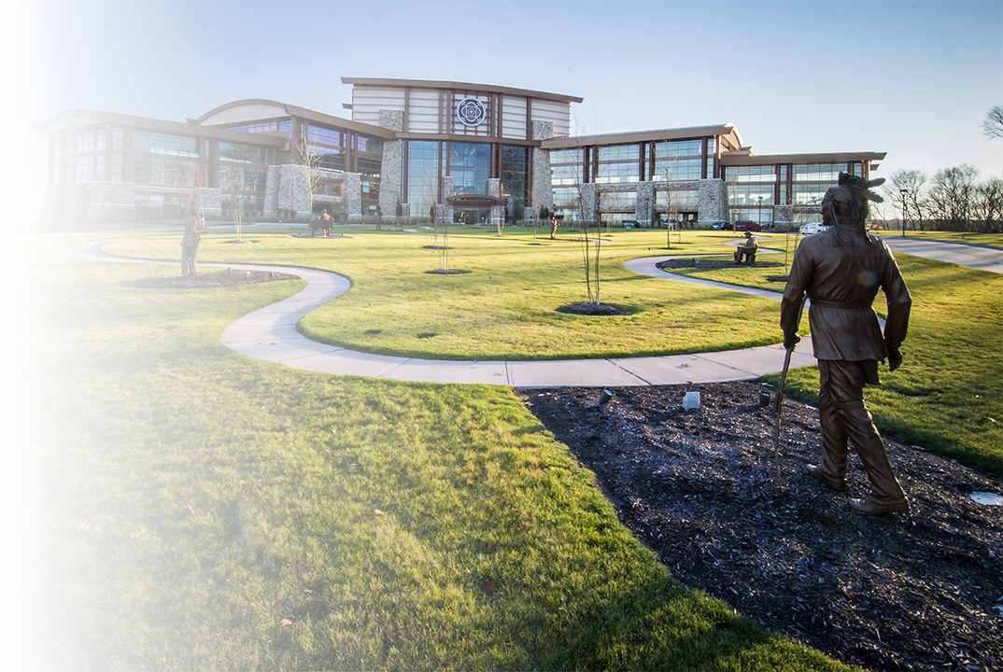
Questions?
Questions?

Slide 10
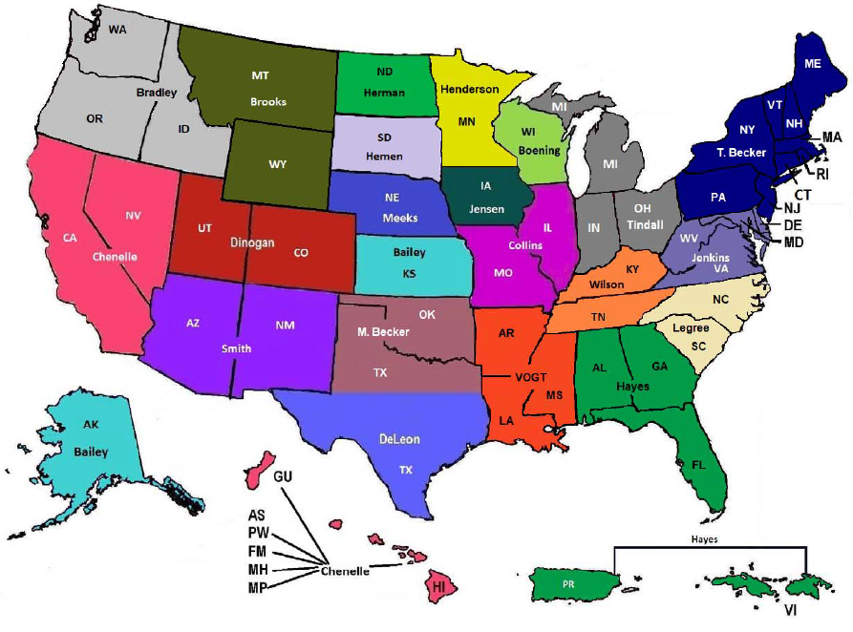

Slide 11
Rural Utilities Service Telecommunications Key Contacts
Assistant Administrator
Chad Parker, Assistant Administrator, RUS Telecom Program
chad.parker@wdc.usda.gov / 202.720.9556
Deputy Assistant Administrators
Laurel Leverrier, Deputy Assistant Administrator, RUS Telecom Program
laurel.leverrier@wdc.usda.gov / 202.720.9556
Peter Aimable, Dep. Asst. Admin, Portfolio Mgmt & Risk Assessment Div.
peter.aimable@wdc.usda.gov / 202.720.1025
Shawn Arner, Dep. Asst. Admin, Loan Origination & Approval Division
shawn.arner@wdc.usda.gov / 202.720.0800
Kenneth Kuchno, Dep. Asst. Admin, Policy & Outreach Division
kenneth.kuchno@wdc.usda.gov / 202.720.0667

Slide 12
Richard J. Anderson, Chief
Fin. Ops. Branch, Loan Orig. & Approval Div.
richard.anderson@wdc.usda.gov | Office: 202.720.0733
Telecommunications Program | Rural Utilities Service
Rural Development | U.S. Department of Agriculture
1400 Independence Ave., SW | Washington, D.C. 20250-1597
www.rd.usda.gov

